Slide 1
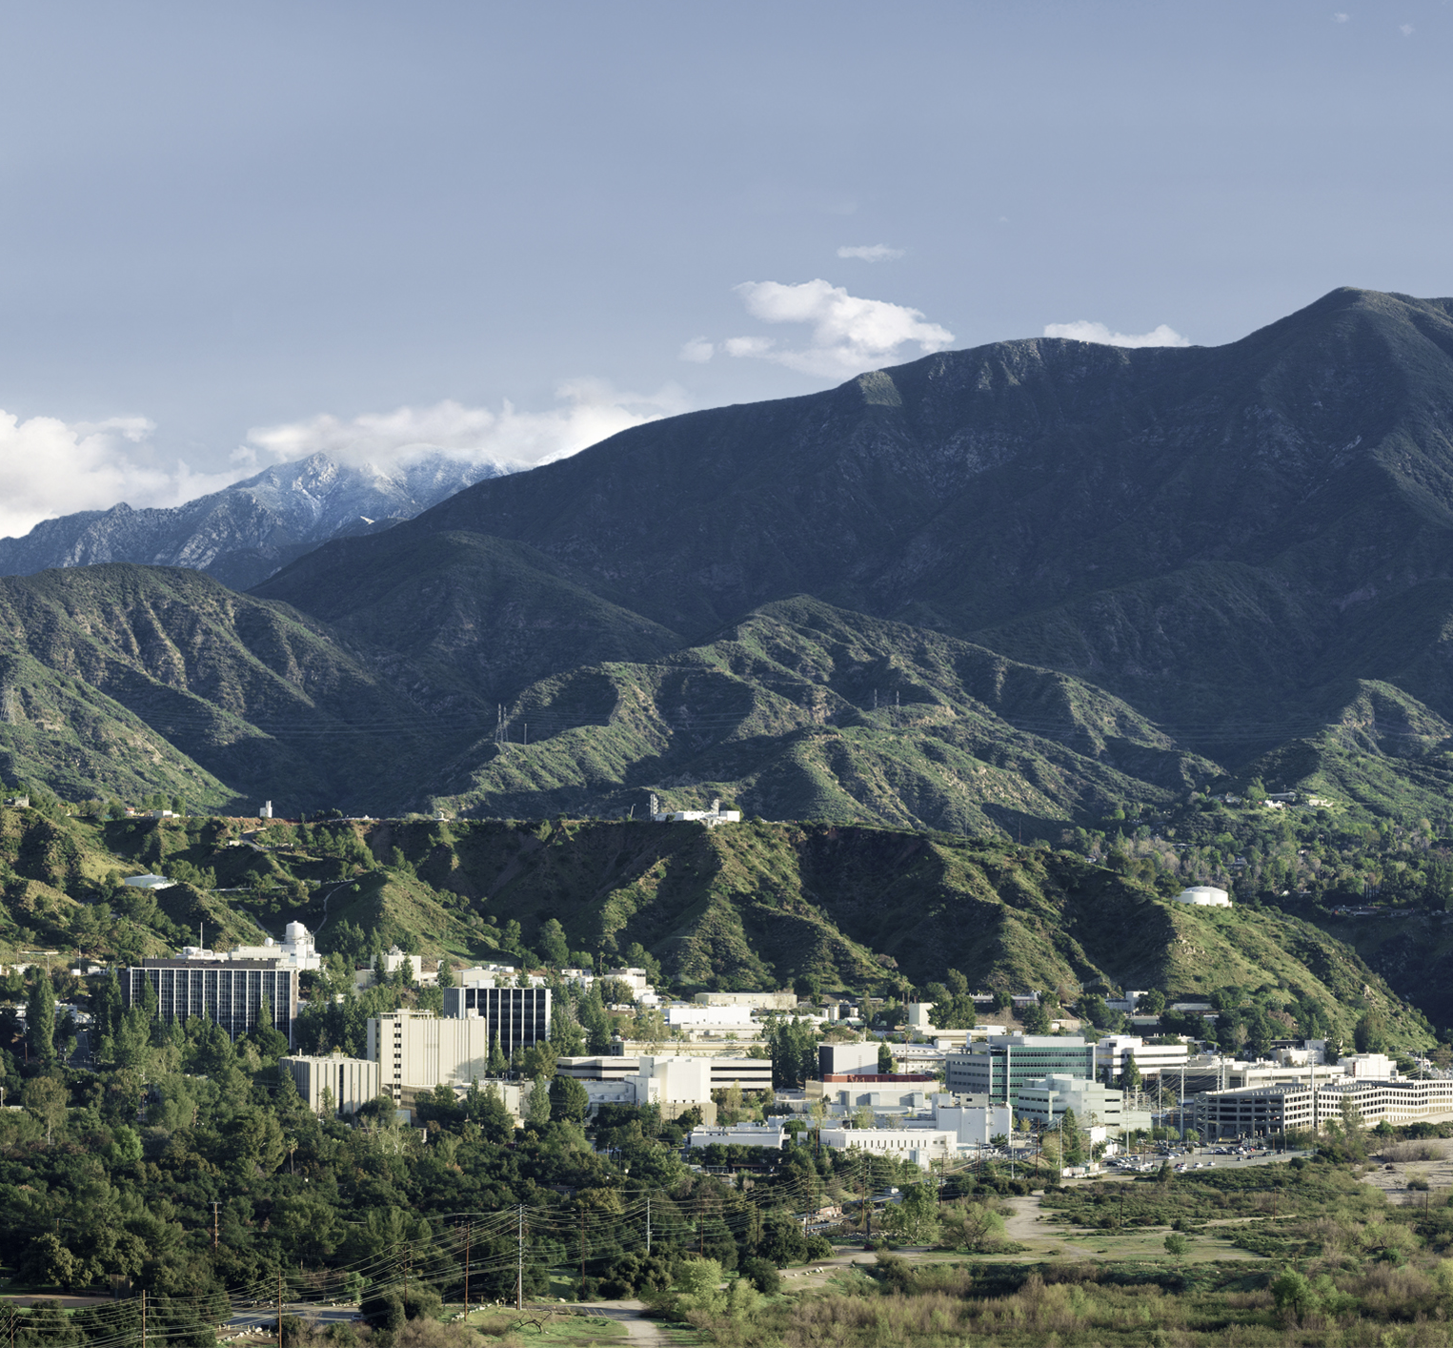
Data Fidelity in Formulation
Trevor Beer
Systems Engineering APX, 312C - Systems Modeling, Analysis, and Architectures
June 13, 2024

Slide 2

About Me
Completed undergraduate studies at UCSB in Statistics and Data Science
Graduating with MS in Statistics from UCLA
Thesis - Generative Data Science: Applications for Early Life Cycle Cost Estimation in the Aerospace Industry
Joined group in April 2023

Slide 3
The Big Picture
Group 312C – Systems Modeling, Analysis, and Architectures
Assist in critical cost estimation tasks during mission formulation activities
Capabilities range - statistical modeling, data engineering (normalization is a subset of this), web-based tool development
Dynamic group with members that come from a variety of disciplines – presented many opportunities to broaden my skillset

Slide 4
My Contributions to the Group
Supported, modified and built web-apps using Pythonic software to provide user friendly modeling and data visualization tools
Harvested, merged and processed raw data into easily ingestible, code-friendly datasets
Normalized incorrect, outdated and/or inconsistent data into clean datasets to ensure high quality data for our modeling efforts
Documented all of my code, scripts and work into Github or Jupyter notebook to make all work traceable

Slide 5
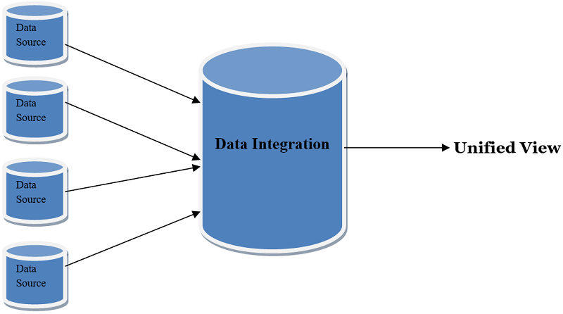
Relevant Data in Cost Estimation
Different types of data depending on task
FTE (Full-Time Equivalent) – characterizes actual workforce effort
Cost – primary variable of interest, includes labor, nonlabor, contributions, and contracts
Technical Parameters – by mission, flight element, instrument, include mass, power, data rates
Schedule – Stages of lifecycle, viewed in “Phases”
Pre-A/A – Study
B-D – Development
E-F – Operations and Mission Close-Out
Each comes with unique normalization challenges/constraints
Reviewed and determined not to contain CUI.

Slide 6
Data Fidelity
Pillar upon which all downstream modeling rests upon
Relevant questions:
Where is data coming from?
Does the data agree with other sources? If not, why?
What (if any) normalizations need to occur to prepare data for analysis?
Normalization – refers to process of transforming variables
Ex. Consistent Fiscal Year for cost, charge accounts mapped to correct WBS
Iterative procedure to account for as much uncertainty as possible

Slide 7
General Process
Identify and compare alternative sources of same parameters – conduct normalizations based on findings and discussion
Produce code script that normalize data yielding quality final dataset for modeling work, with documentation of normalizing procedures
Speak with Cost and Systems Engineers to identify parameters of interest and current fidelity of data
Initial data visualization with Python or R

Slide 8
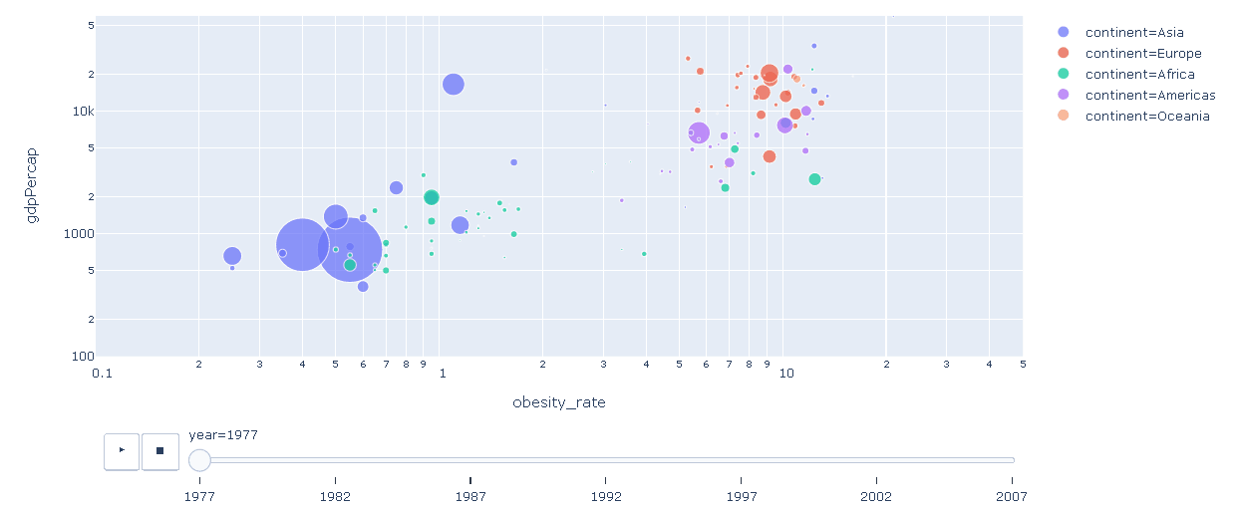
Processing Tools
I focused on Python, particularly the Pandas and Plotly packages for data frame manipulation and visualization creation
Plotly – allows for interactive visuals, elevating users’ ability to control their analysis experience
Both packages scale well with large datasets in terms of visualization and normalization capabilities

Slide 9
Examples of Sources
Oracle Database – Provides granular workforce records, monthly FTE’s and cost for various projects
Work Definition – Project level records and schedule
CADB – Project level costs by Fiscal year, with information about project phases and WBS mappings
ZAP – 312C Database intended to serve as warehouse for “gold standard” data based on normalizations conducted
My work consisted of gathering, merging, and pre-processing data from these sources to generate high-quality datasets for modeling tasks

Slide 10
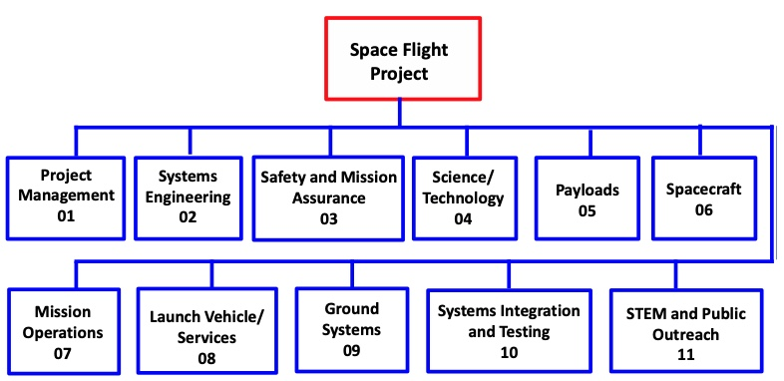
WBS Normalizations
Work Breakdown Structure provides common framework for projects to bucket work by major mission components
JPL uses NASA Standardized WBS, with addition of WBS 12 – Mission Design Navigation (MD Nav)
Older records may be missing, incomplete, or reflect dated WBS standards which make interpreting through present WBS lens more difficult
Normalizing Procedures:
CADB – Records from 2X that define WBS mappings and account for changes in bookkeeping over time
Identify keywords, talk to personnel from projects “grassroots normalization”
Reviewed and determined not to contain CUI.

Slide 11
FTE/Cost Normalizations
FTEs – Monthly or yearly, must determine how to display calculations for interpretable results
Cost – Standard to inflate to current fiscal year
Labor rates do not change 1-1 with inflation, meaning simply inflating may not be sufficient to compare costs temporally
FTEs are best indicator of raw workforce efforts, but ultimately cost is the variable of interest in most analyses
Analyzing actuals from formulation lens is difficult:
How to back out reserves?
Account for slips or other events not typically considered in early life cycle
Reviewed and determined not to contain CUI.

Slide 12
ICM Modeling Background
ICM Model – Institutional Cost Model is a section approved model that serves to quantify cost based on general parameters that guide mission development in formulation
Such as planned schedule, anticipated FTE breakouts, and broad technical considerations like the intended target
Must be signed off by institutional manager – imperative that the calculations and results output represent our best and most accurate efforts to provide high-fidelity cost estimates
My efforts focused on the model to build WBS 05 and 06 estimates, which correspond to Instrument and Spacecraft management and systems engineering
Reviewed and determined not to contain CUI.

Slide 13
ICM Modeling Background
Speaking to project leads informs us that bookkeeping processes are not perfect during development as indicated in Oracle, so the CADB exists in order to identify and amend bookkeeping errors after they are initially recorded
This process is critical because the ICM Model must be informed by actual data, and incorrect bookkeeping could lead to over or underestimation of the target WBS
Reviewed and determined not to contain CUI.

Slide 14

ICM Modeling Background
I conducted various normalization procedures on the raw data of over 1.6 million entries, including:
Merging CADB mapping of WBS to raw Oracle data to correct known bookkeeping errors
Manual WBS normalization based on WBS keywords (such as Payload SE, Flight System SE, etc) to catch unknown mappings
Merged mission level characteristics such as Cost Category to allow visualizing groups of missions easily
Mapping entries to the proper phase by Project Number and date with CADB and Work Definition information
Reviewed and determined not to contain CUI.

Slide 15
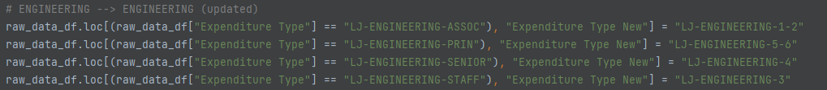
ICM Modeling Example
The procedures from the previous slide were conducted on both Cost and FTE data to allow further analysis of labor rate calculations and assist in model validation
I created a Python script to automate as much of this process as possible, merging the unique relational data frames and generating an output CSV that is ready for immediate analysis
Results stemming from validation with data I normalized serve as key motivator to update model in order to best reflect how JPL conducts business in higher level of detail than previously possible
Reviewed and determined not to contain CUI.

Slide 16
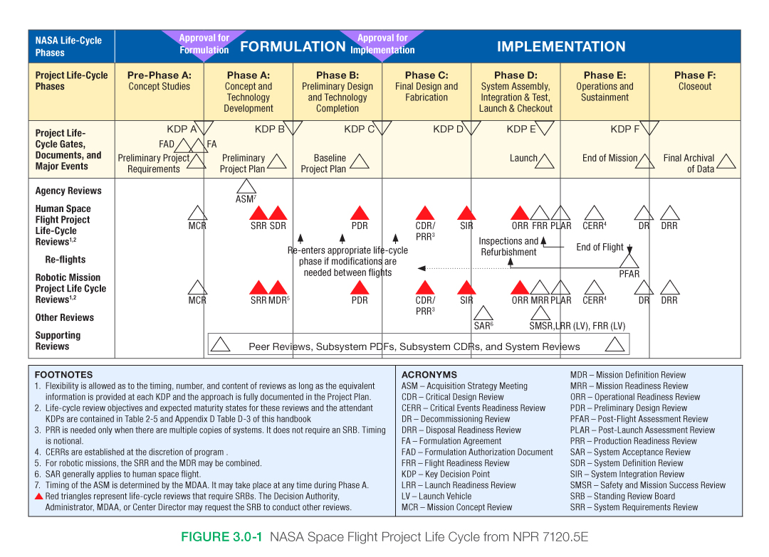
Schedule Normalizations
Schedule and Phases are projected at different checkpoints, such as PDR, SIR, and EoM
Differences in schedules based on various factors – launch windows, internal/external slips, funding availability
Which form of schedule will best inform models?
Reviewed and determined not to contain CUI.

Slide 17
Schedule Normalization Example
ICM model uses phase lengths to build mission profile to better understand how time drives cost
Phases B, C, and D (development) correspond to the highest degree of work on Payload and Spacecraft components
I aided in efforts to document these schedule discrepancies from plans and actuals and identify rules of thumb to breakout sub-schedule durations that are used in mission planning
Identified source of schedule slips (internal or external) and removed months pertaining the delays caused by non-JPL factors
Delivered processed and documented schedule data to incorporate in ZAP, the 312C visualization and data warehouse
Reviewed and determined not to contain CUI.

Slide 18
Technical Data Normalizations
May wish to utilize technical parameters from flown missions and studies to deduce cost estimating relationships (CERs)
Parameters may be given on instrument, flight element, or mission basis
Studies can include multiple design scenarios with different values – must choose what to accept for analysis
Reviewed and determined not to contain CUI.

Slide 19
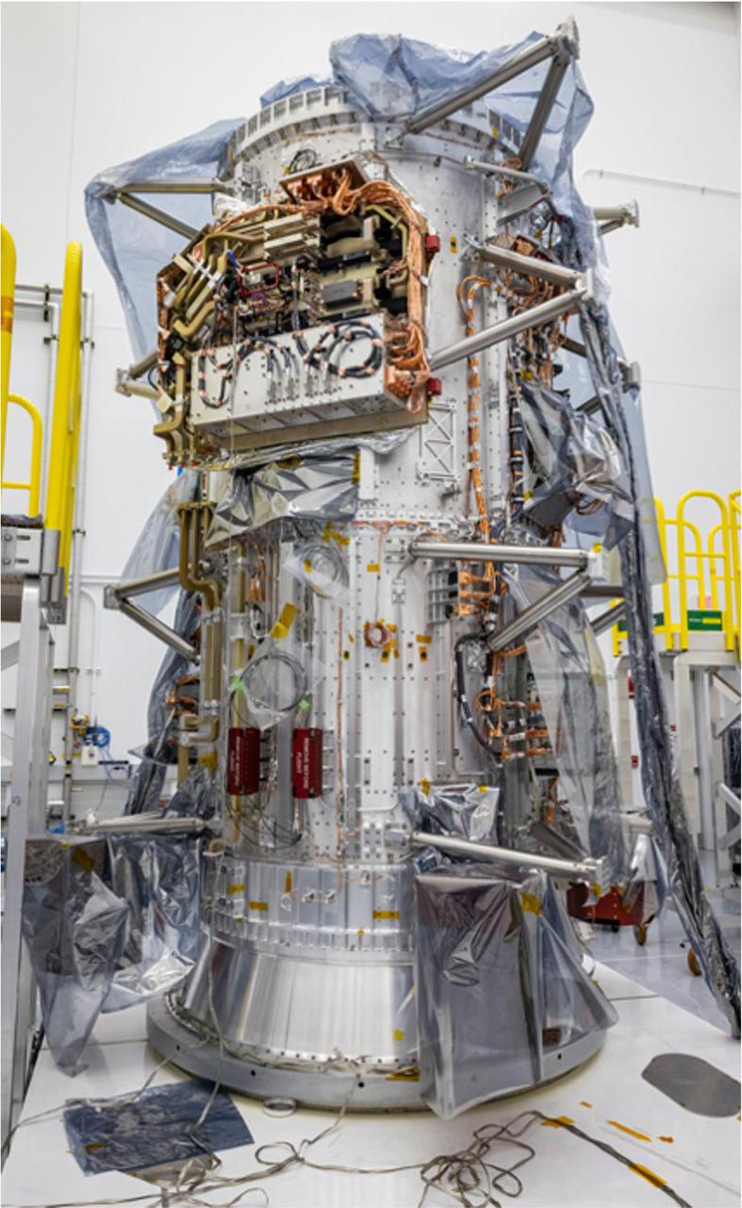
Technical Data Normalizations Example
MCDB – Mission and Cost Database
MCDB task aims to unify actual flown data and study to create comprehensive “gold standard” technical data for missions, flight elements, and instruments
I read and documented study reports and workbooks to intimately understand mission objectives and identify parameters of interest
Provided data to personnel responsible for updating database
Mission | Mass (kg) | Power (kW)
A | 500 | 26
B | 2000 | 45
C | 1500 | 30
Reviewed and determined not to contain CUI.

Slide 20
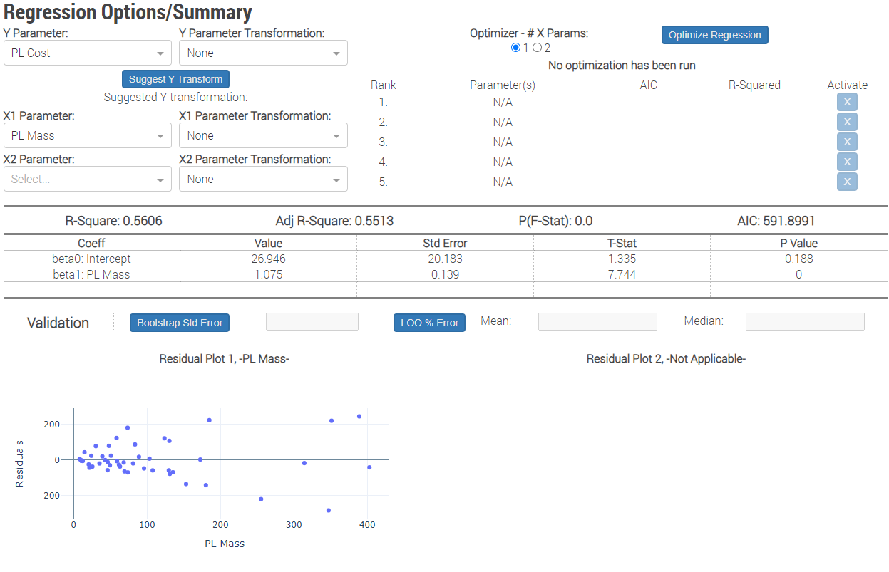
Technical Data Normalizations Example
Technical data is used to model relationships between physical parameters and cost, such as in the A-Team Regression (ART) tool
Quantifying these relationships with regression works well within our generally low-data paradigm (more complex models may overfit)
Allows the user to explore strength of different CERs, such as mass vs cost, data rate vs cost
Reviewed and determined not to contain CUI.

Slide 21
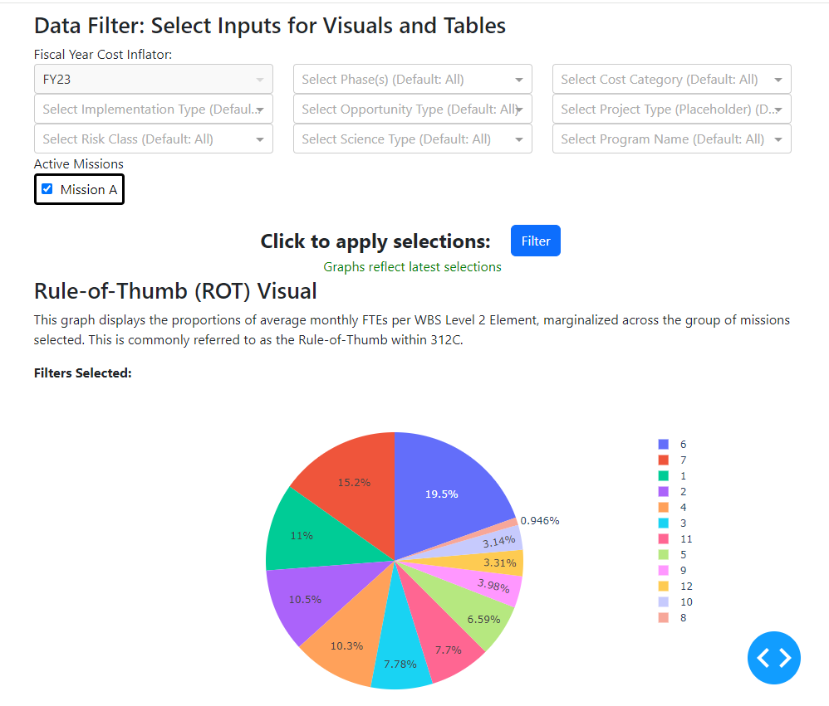
Workforce Analysis Visualization and Exploration Tool
Otherwise known as WAVE, part of 312C Suite of tools
https://costing.jpl.nasa.gov/dash/wave/
I created using Dash – a Pythonic framework for creating powerful data science oriented web apps
Integrates elements of WBS, FTE, Cost, and Schedule normalizations I conducted in backend data with simple filters and user interface on frontend
This data is local right now, with plans to integrate backend directly to ZAP
Use case: quickly identify most prevalent expenditure categories in WBS 05 and 06 to inform ICM model
Reviewed and determined not to contain CUI.

Slide 22
Summary
Led data normalization procedures for data used in various critical tasks including ICM Model updates and MCDB data collection
Expanded the capabilities of 312C web presence with the WAVE tool
Created scripts and templates in Python and R to provide standardized and traceable normalization procedures on various data, namely cost, FTE, schedule, and technical parameters
Learned about fundamental JPL engineering and business practices and integrated lessons from cost and systems engineers into data normalization process
Reviewed and determined not to contain CUI.

Slide 23
Acknowledgements
Michael Saing and Anto Kolanjian
Served as my primary mentors for the duration of my internship
Provided invaluable domain knowledge, guidance on tasks, and freedom to explore projects of interest
Patrick Bjornstad and Patricia Gallagher
Collaborated with on a number of projects including web development, ICM, DAG, MCDB
Reviewed and determined not to contain CUI.

Slide 24

Additional Acknowledgements
Weekly Math/Stats reading group – engaging discussions on statistical/ML techniques with eye towards applications in our daily work
Weekly Tag-Ups – presented opportunity to engage in discussions surrounding other activities performed by group members and understand broader scope of group impact
Reviewed and determined not to contain CUI.

Slide 25
Thank You!
Reviewed and determined not to contain CUI.

Slide 26
Reviewed and determined not to contain CUI.

